Slide 1
Up, up and away! The evolution of superman
Prof. Jaq greenspon

Slide 2
The Birth of Superman

Slide 3


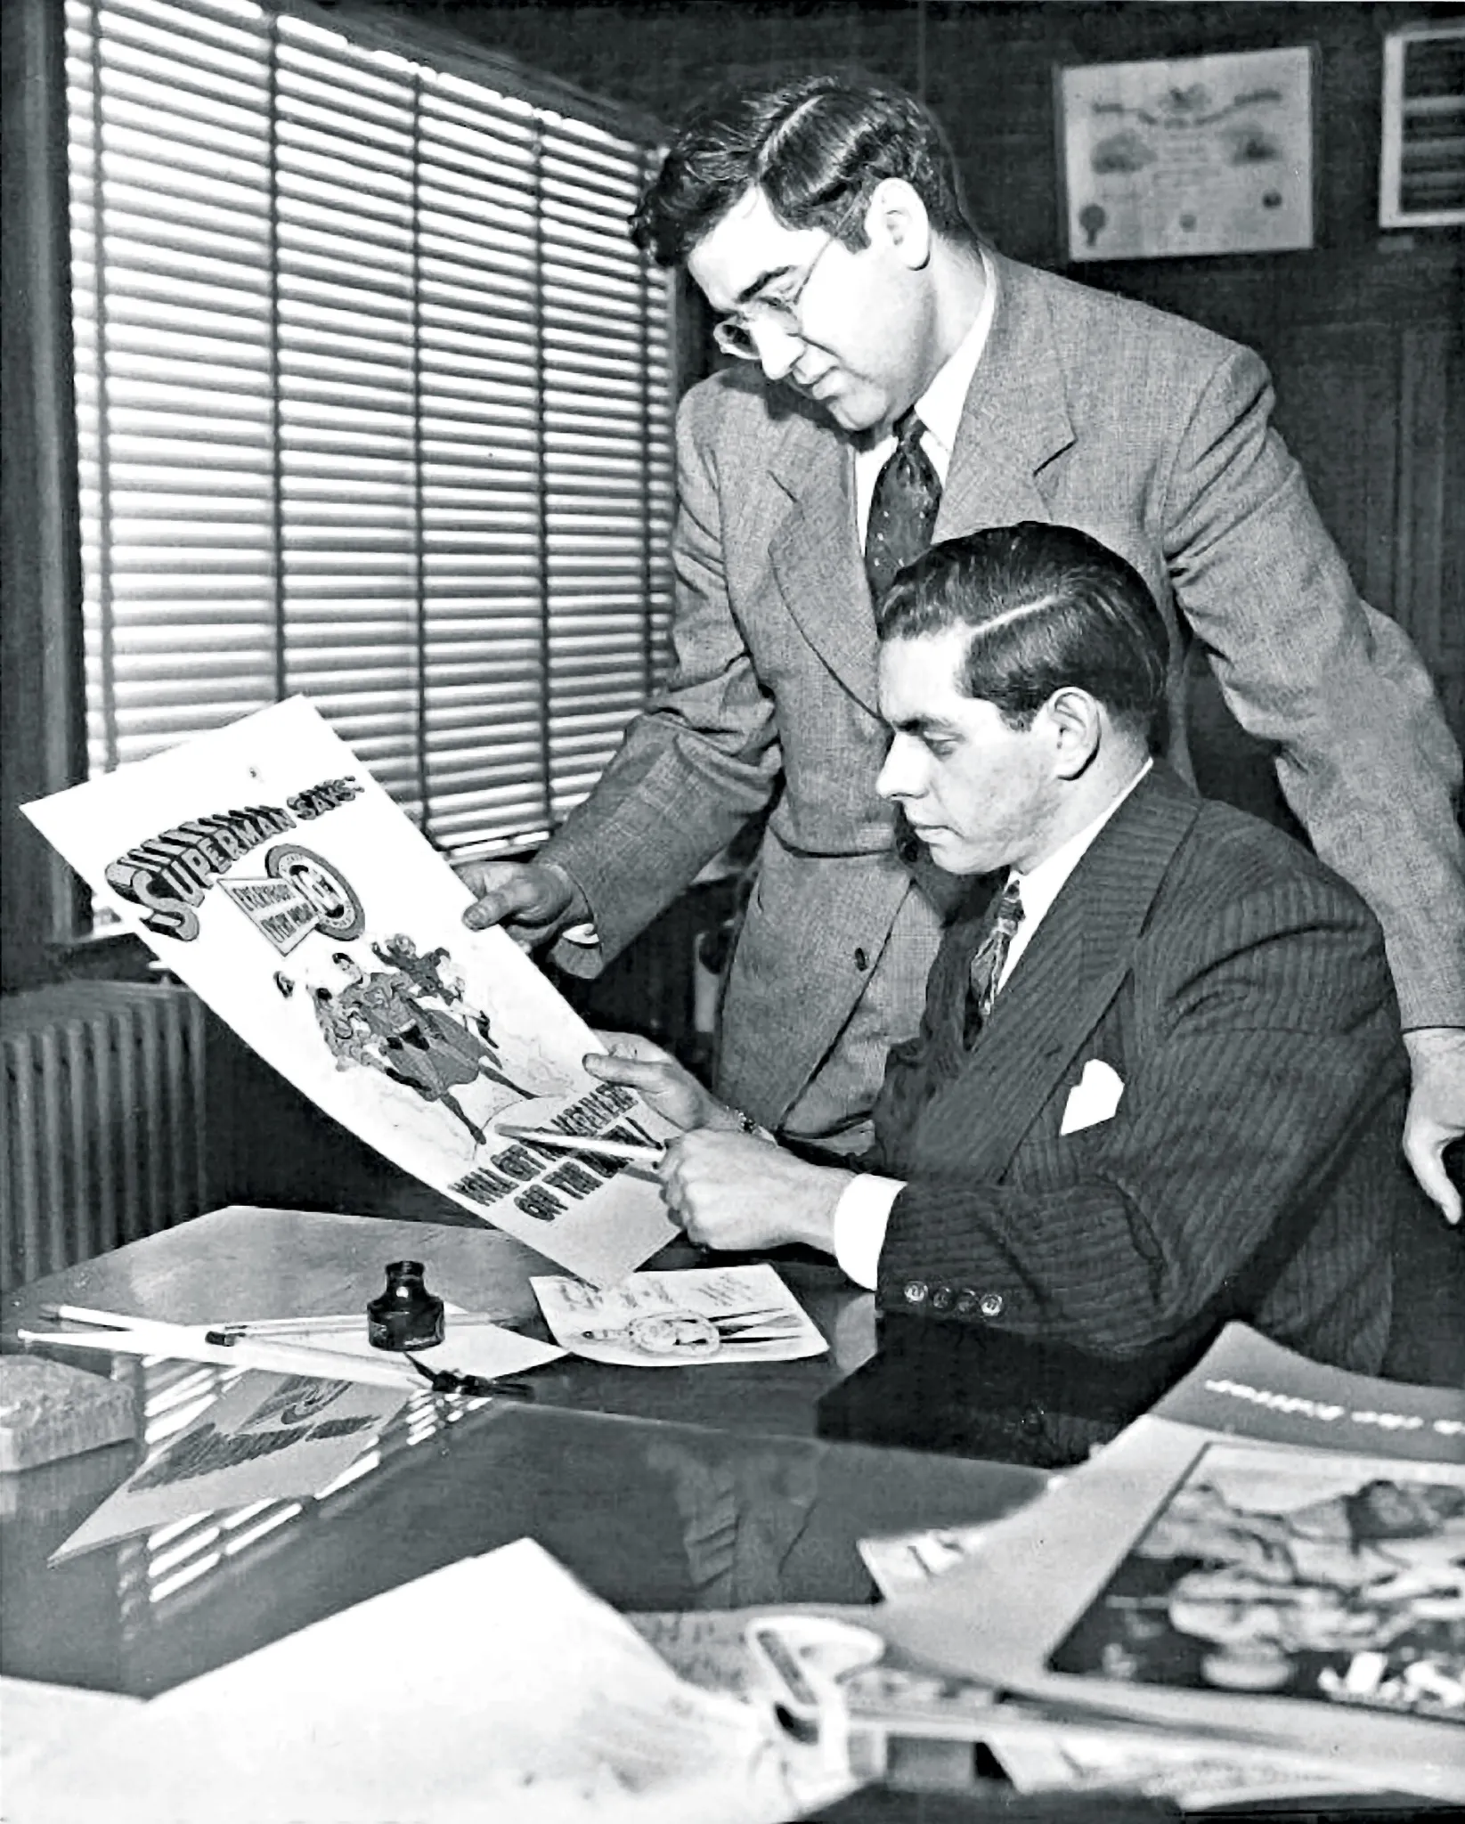
Jerry Siegel &
Joe Shuster
Jewish immigrants and a local, Lithuanian connection
“Rise of the Superman” (1933)
Trying to break into newspaper strips
Wrote Slam Bradley
Sold Superman for $130

Slide 4
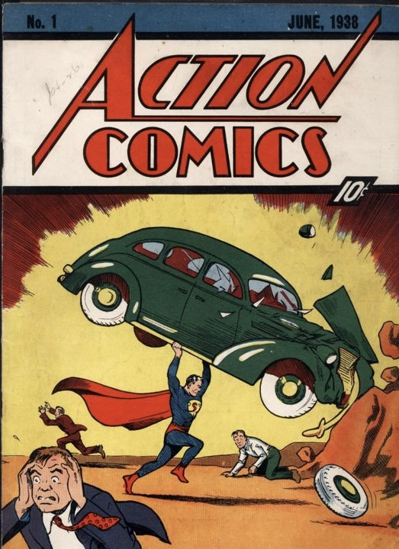
Action Comics #1 (April 18 (June?)1938)
Influenced by pulp heroes (Doc Savage, The Shadow), mythology (Samson, Moses), and the immigrant experience.
He was the opposite of what had come before – An alien on Earth.

Slide 5
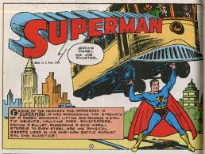
Golden Age Superman – champion of the oppressed
Starts the Golden Age of Comics
Couldn’t fly…yet
Took on corrupt businessmen, abusive husbands, and warmongers—a hero for the common man during the Depression.

Slide 6
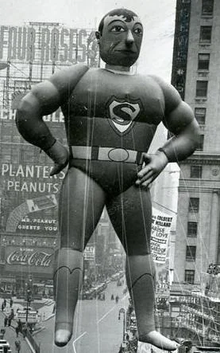
The Golden Age & Rise to Fame

Slide 7
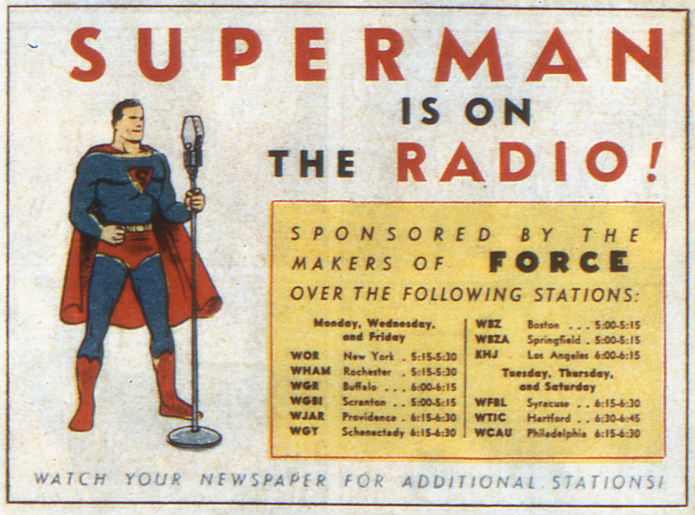
Radio show (1940)
”It’s a bird! It’s a plane! It’s Superman!!”
Introduced now common elements like Perry White and Kryptonite

Slide 8
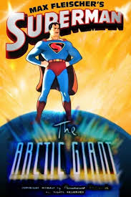
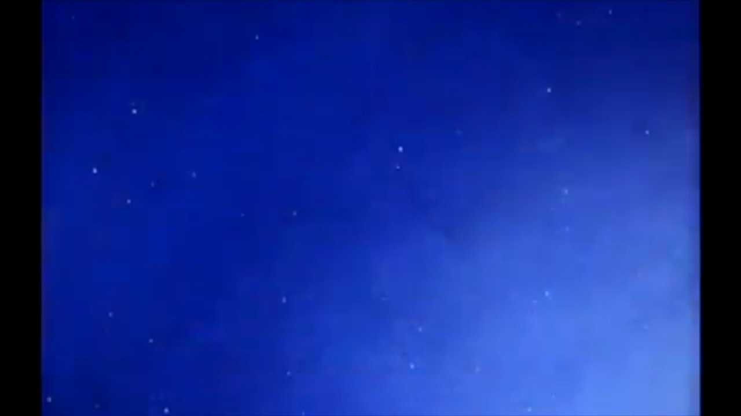
Fleischer cartoons (1941)
Brought Superman to the big screen
Highly stylized
He could now fly – easier to animate than leaping.

Slide 9
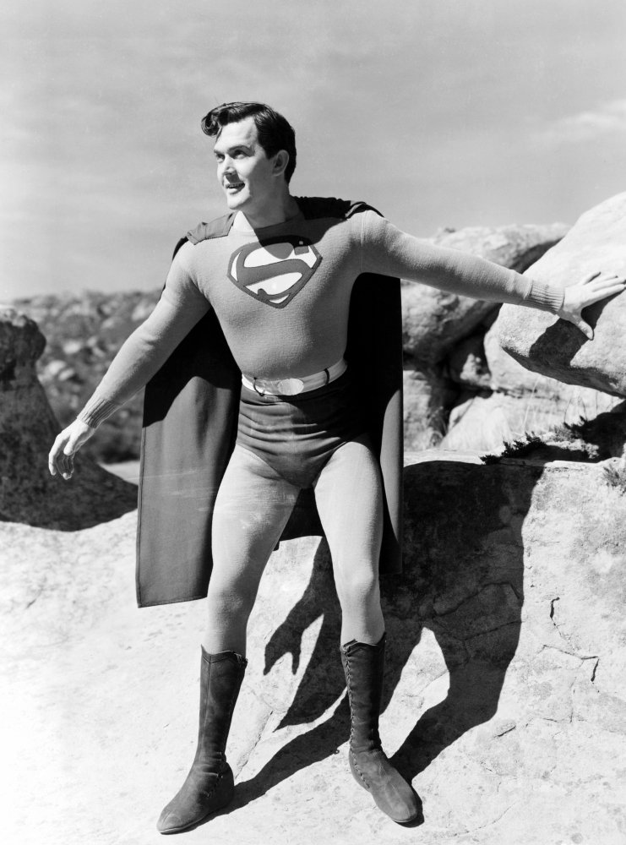
Kirk Alyn serial (1948)
15 episodes
First live action Superman
Noel Neill as Lois Lane
Animated flight
  Take offs on camera
  Landings behind an object

Slide 10
The Silver Age & Superman’s Evolution

Slide 11
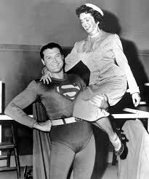
Adventures of Superman TV show (1952-58)
George Reeves and Noel Neill (back)
Defined the character for a generation

Slide 12
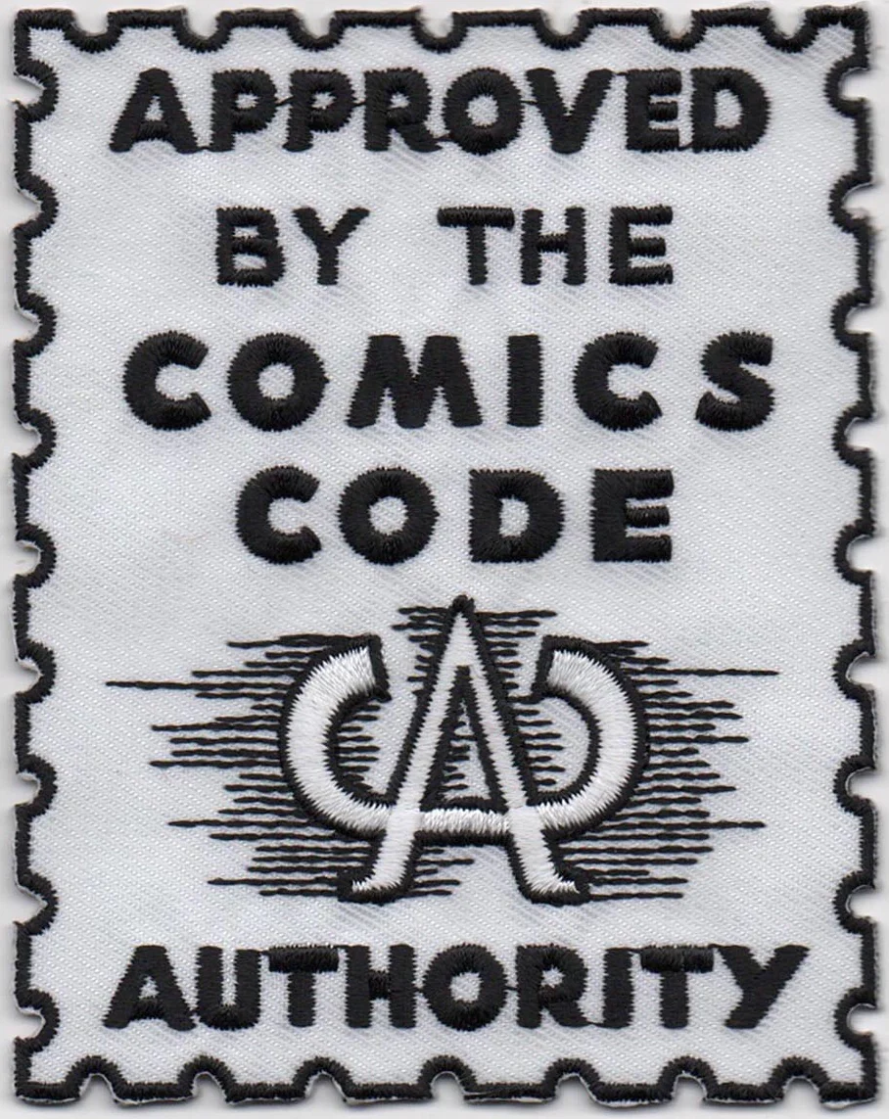
Comics Code Authority (1954)
Superman gained more powers
More wholesome stories
Limitations lead to creativity

Slide 13
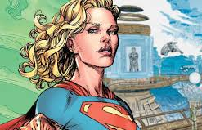
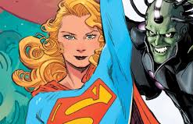
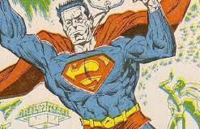
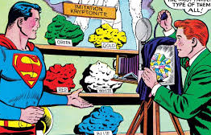
Silver Age and the Expanded mythology:
Krypton
Supergirl
Brainiac
Bizarro
multicolored Kryptonite

Slide 14
Modern Era: Reinvention & Challenges

Slide 15
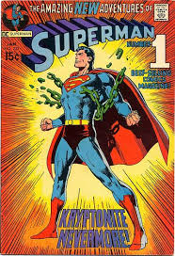
Bronze Age: darker themes (1970s)
Superman is depowered and rebooted
  Kryptonite Nevermore (1971)
Faces more social issues
  Poverty, corruption, pollution
  A return to beginnings

Slide 16
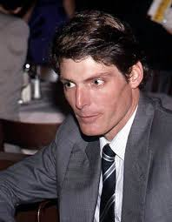
Superman: The movie (1978)
“You’ll Believe a Man Can Fly”
  Richard Donner (dir)
Christopher Reeve
  Humanizes the character
  Puts Clark Kent before Superman

Slide 17
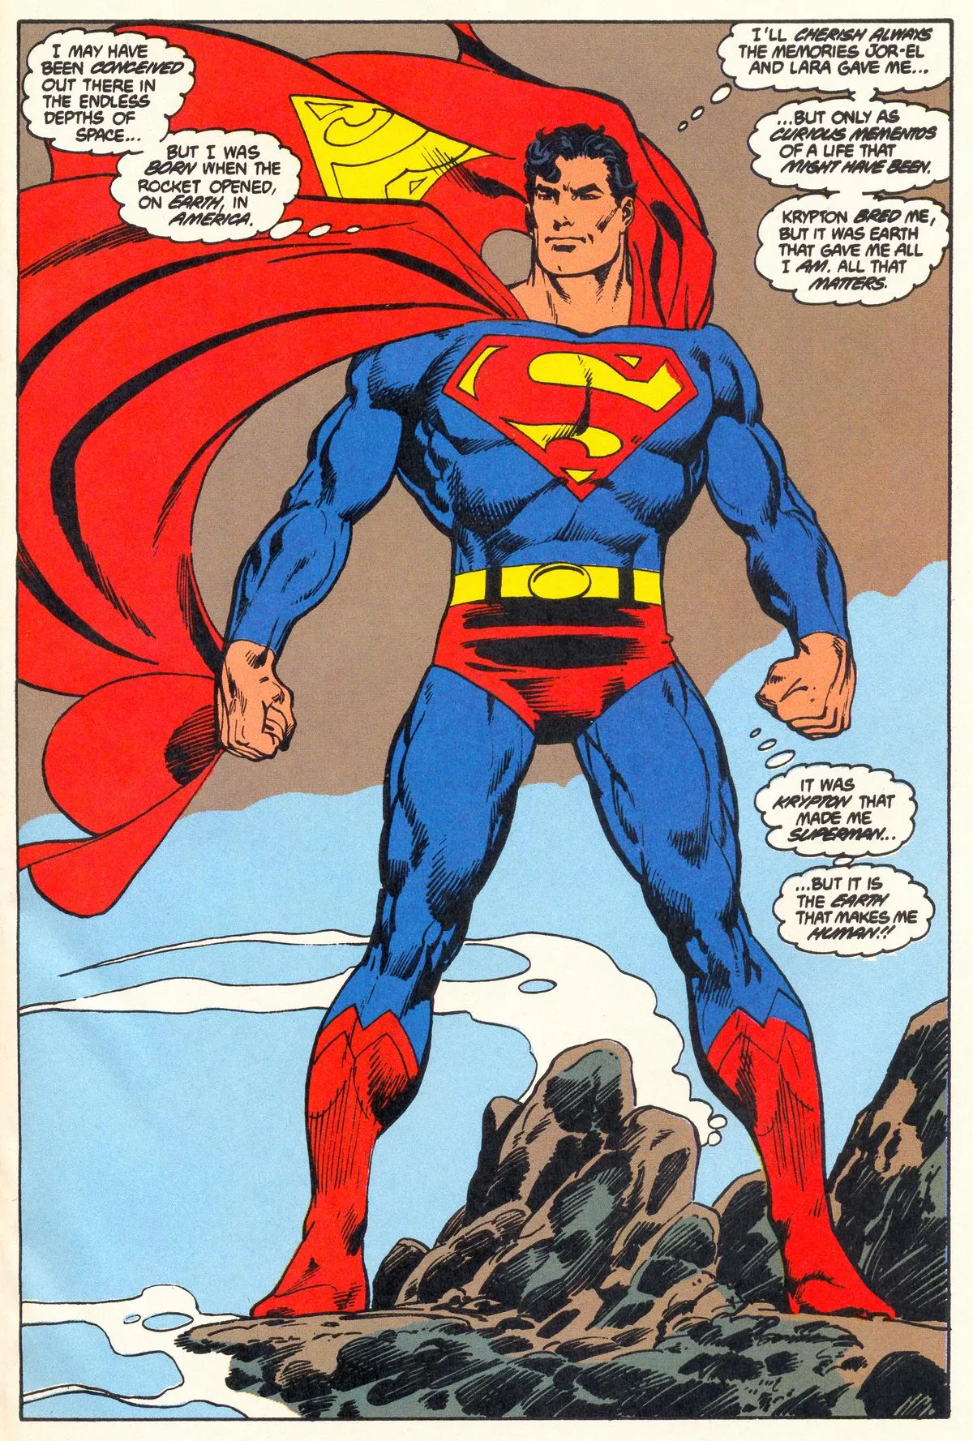
Man of Steel reboot (1986)
John Byrne Reinvents Superman
“It was Krypton that made me Superman…but it is Earth that makes me Human!!”
  Focus on his humanity and not his godhood
Lex Luther is now a corporate CEO

Slide 18
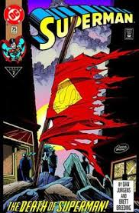
Death of Superman (1992)
Superman vs Doomsday
  He wins but dies
Not meant to be a big deal
  Media gets hold of the story
  Superman replaced by 4 different heroes:
    Steel
    Superboy
    Cyborg Superman
    The Eradicator
Superman returns, more cynical
Comics become spectacle driven

Slide 19
21st Century Superman

Slide 20
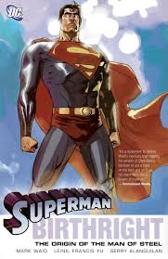
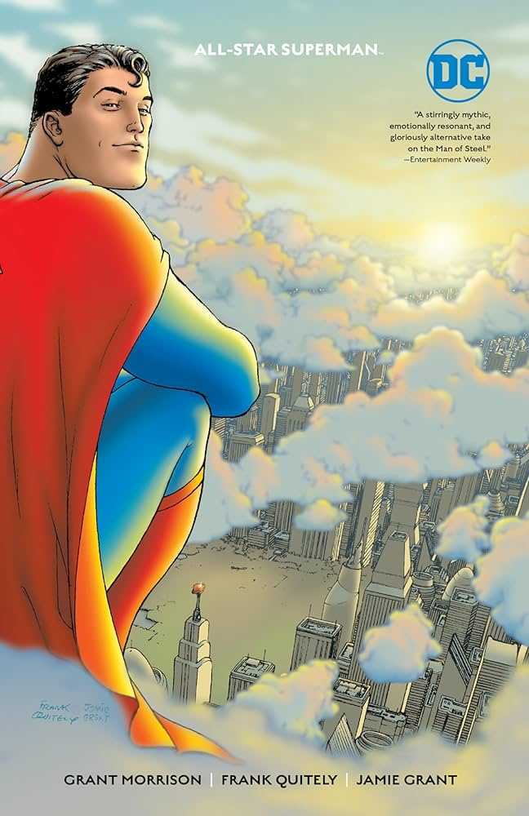
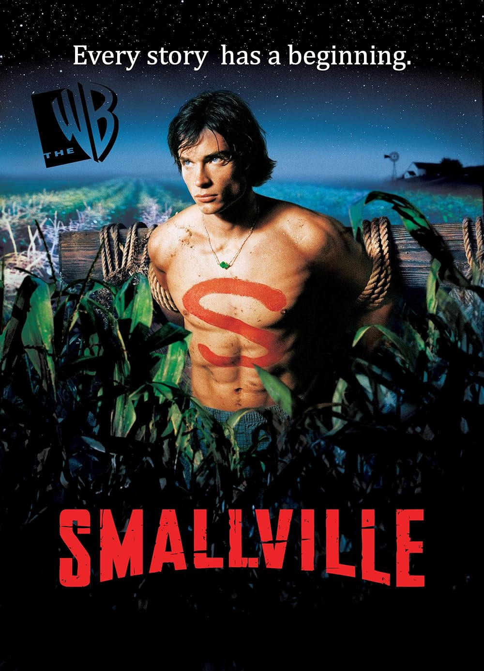

Search for relevance (2000s)
Comics
  Birthright (2003)
    Waid and Yu
    New Origin with focus on immigrant story
  All-Star Superman (2005)
    Morrison and Quietly
    Saying Goodbye, death again
TV
  Smallville (2001-2011)
    Young Clark (Tom Welling) learns about his powers
  Superman and Lois (2021-2024
    Focuses on Cark as husband/father with only bits of Superman

Slide 21
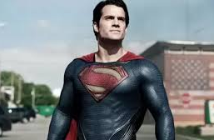
DCEU films
Man of Steel (2013)
  Zach Snyder’s vision
    Darker
    Cavill is more cynical, more alien burdened by power, less human
    Divisive amongst fans

Slide 22
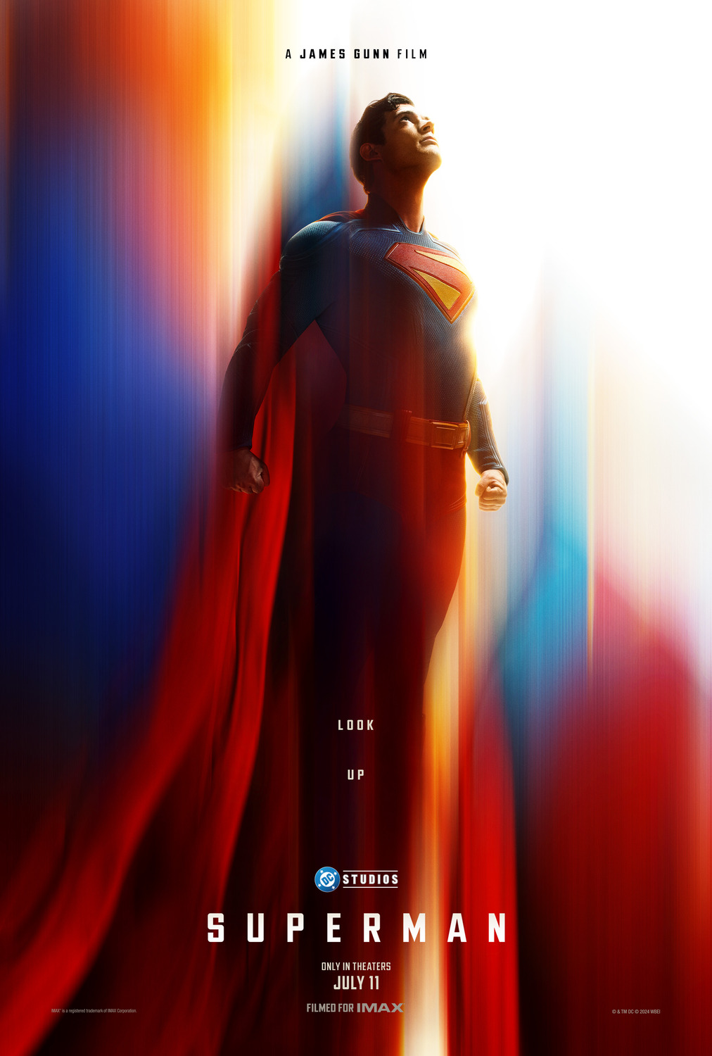
Superman (2025)
Superman (2025)
  James Gunn’s vision
    Return to hope and humanity

Slide 23
Conclusion & Discussion

Slide 24
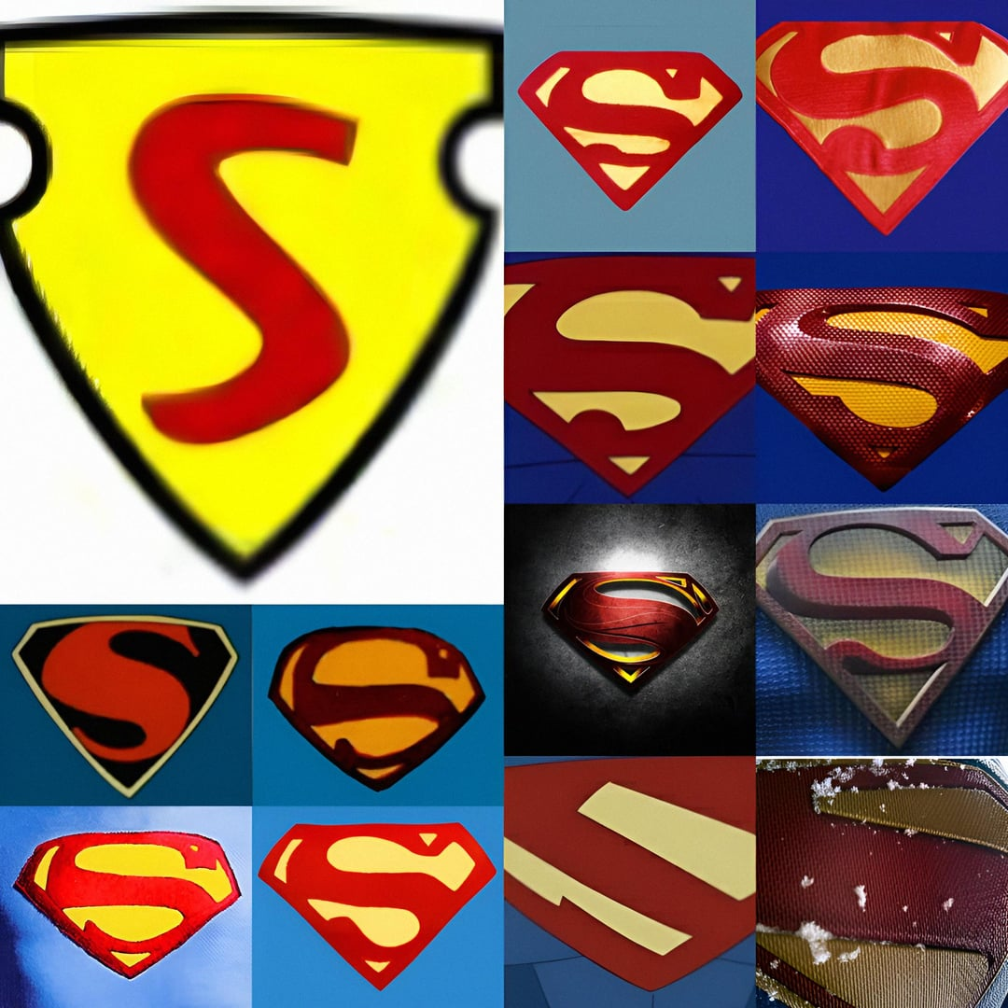
Superman as symbol of hope
Superman is constantly being redefined.
He’s both alien and human and godlike yet humble

Slide 25
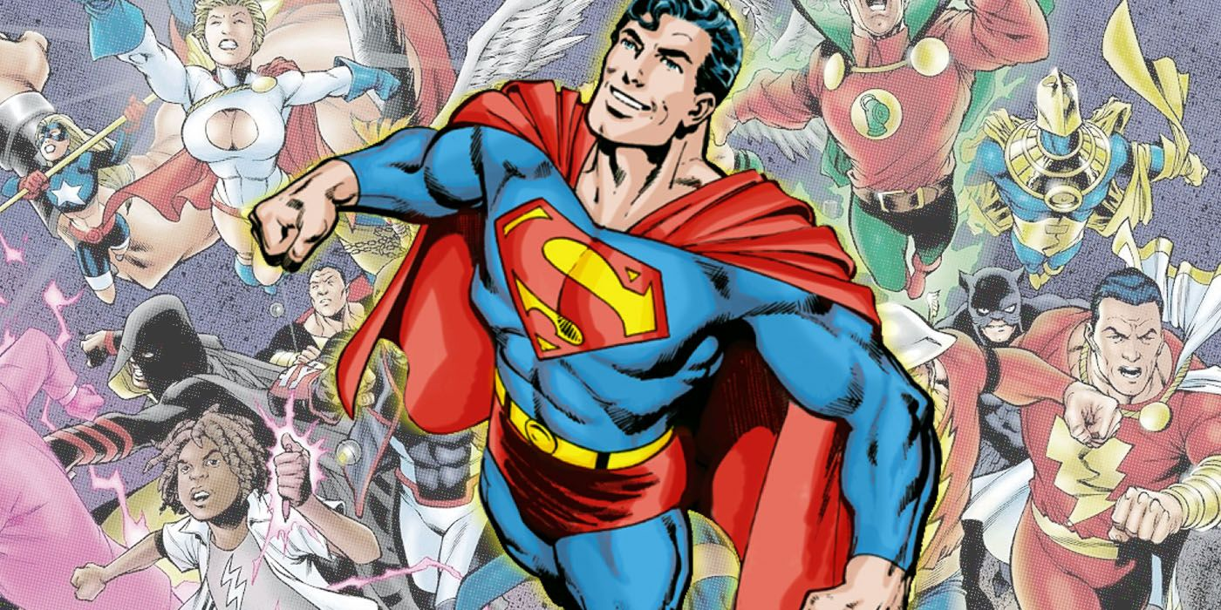
Evolving with society
As society changes, Superman reflects its values:
  1930s: Economic protector
  1950s: Space-age optimism
  1980s: Humanized realism
  2000s+: Questions of identity, responsibility, and morality
He started as a symbol of justice for the oppressed, became a Cold War-era ideal, and later embodied the ethical dilemmas of power and responsibility.

Slide 26
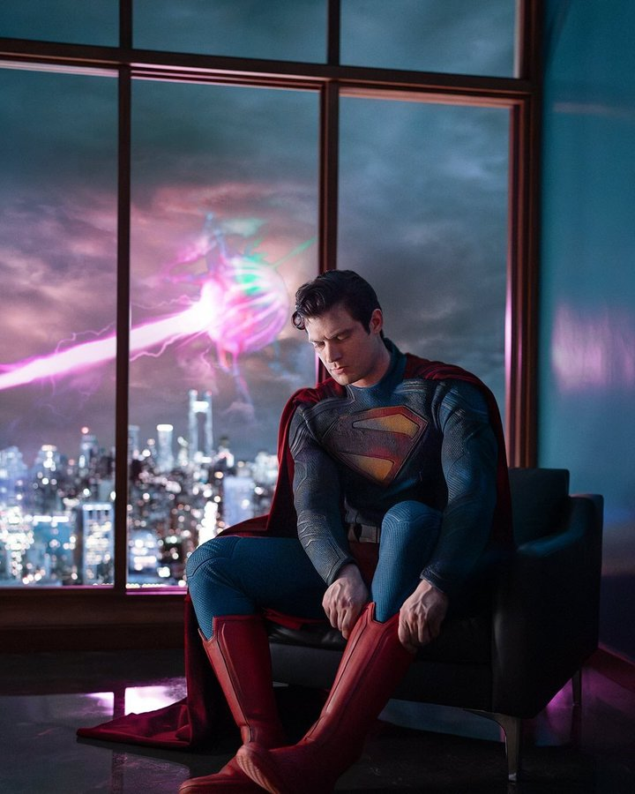
What does Superman represent today?
Superman changes because we change.
What changes are coming?
  Do we still need Superman as an idealized hero?
  Have we, as a society, outgrown his optimism?
  What do you think?

Slide 27

Thank you for watching and look up to the skies

